Slide 1

Prasanth G
310819205057
B.TECH., Information Technology

Slide 2
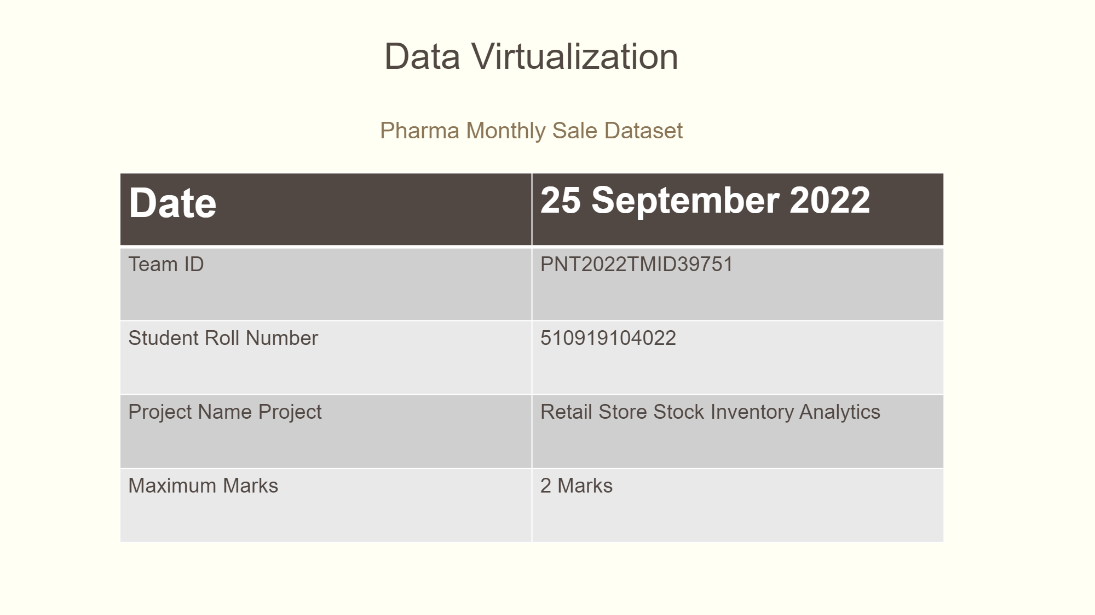
PNT2022TMID27175
310819205057
RETAIL STORE STOCK INVENTORY ANALYTICS

Slide 3
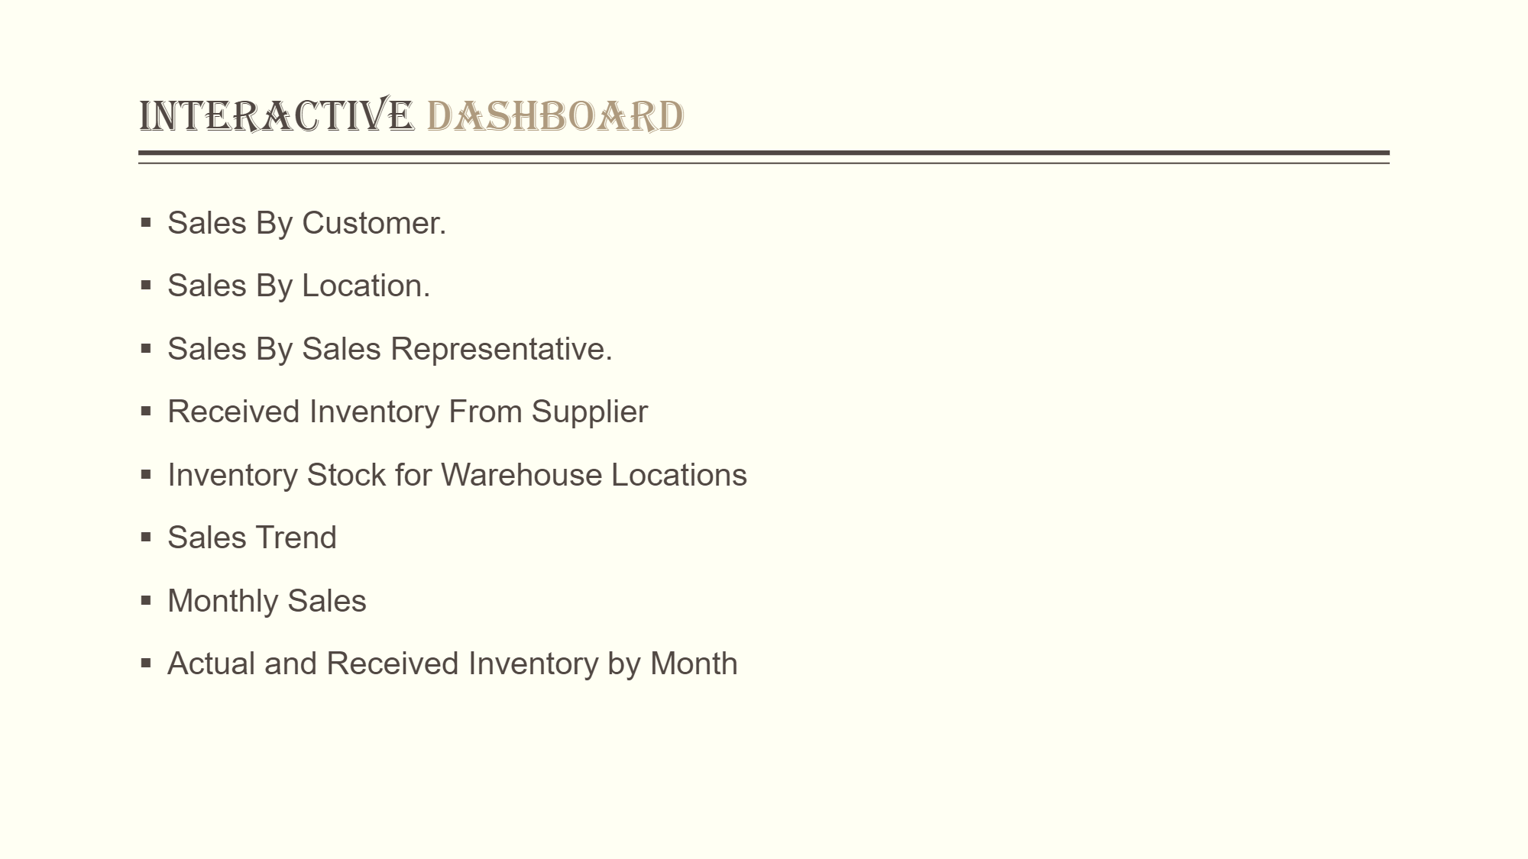

Slide 4
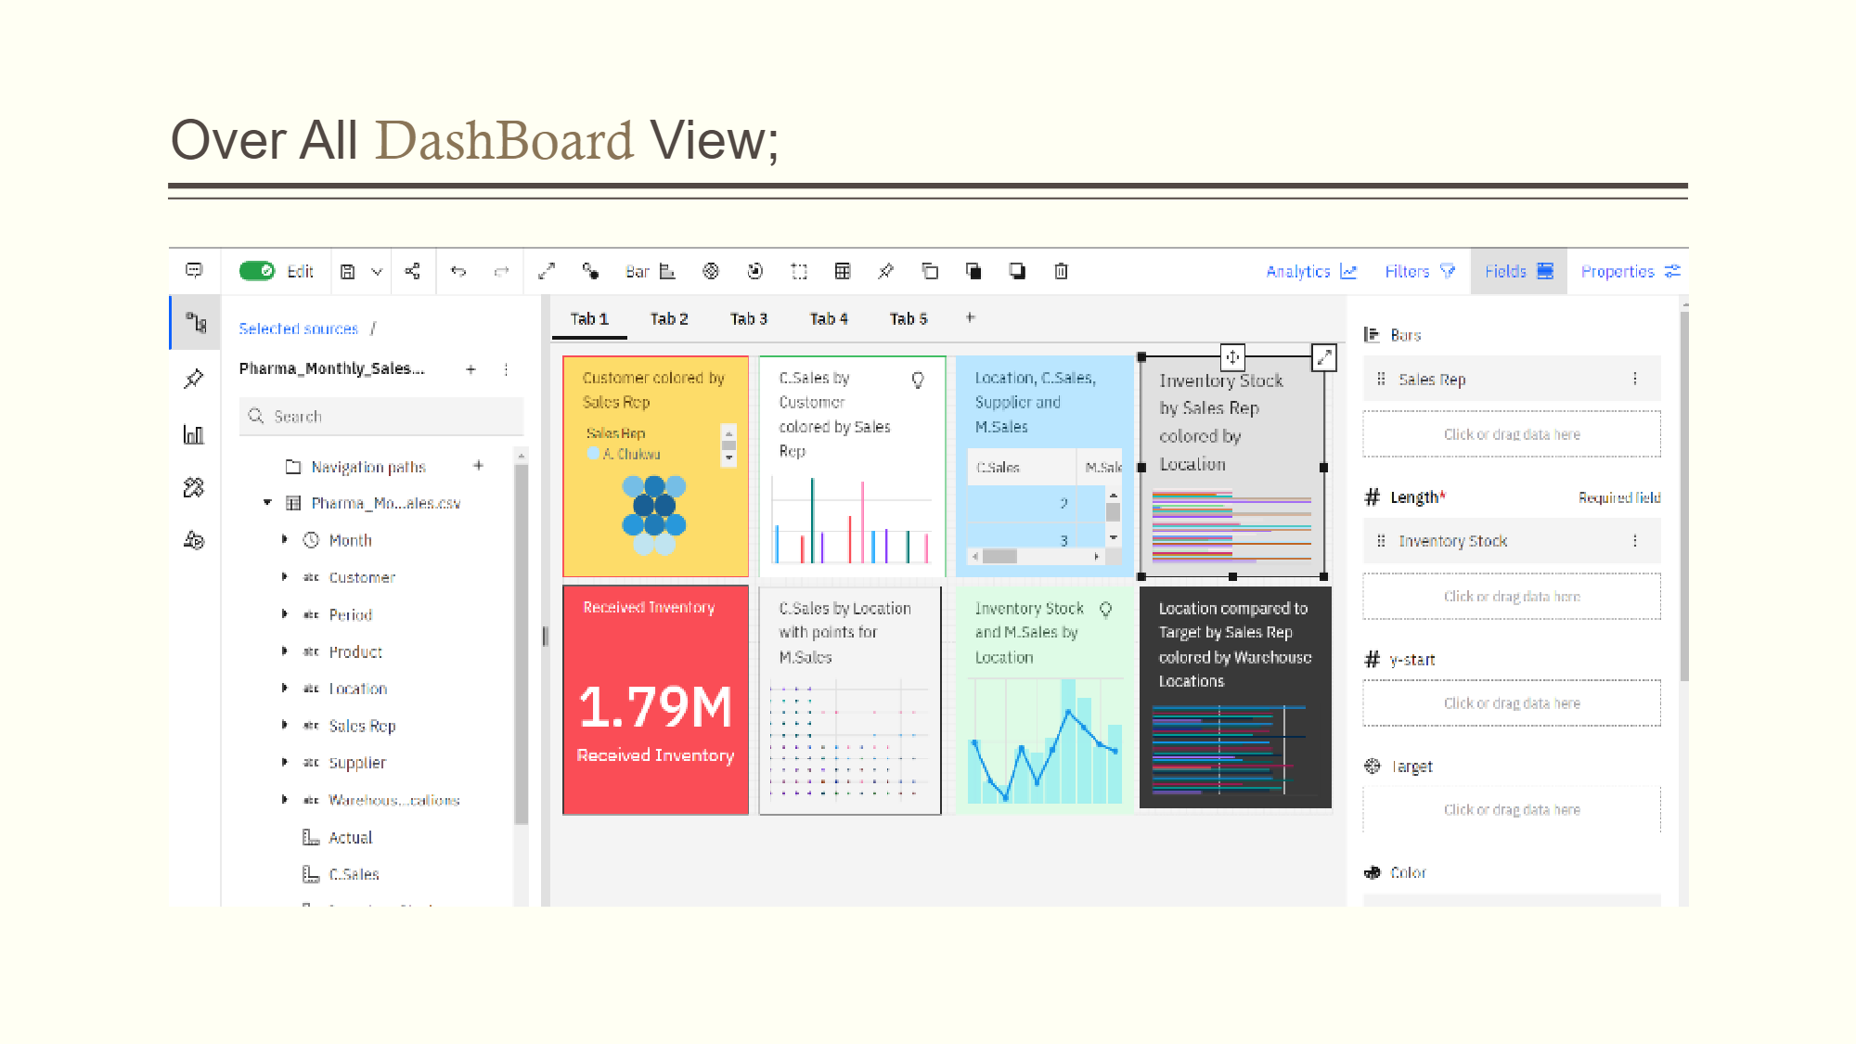

Slide 5
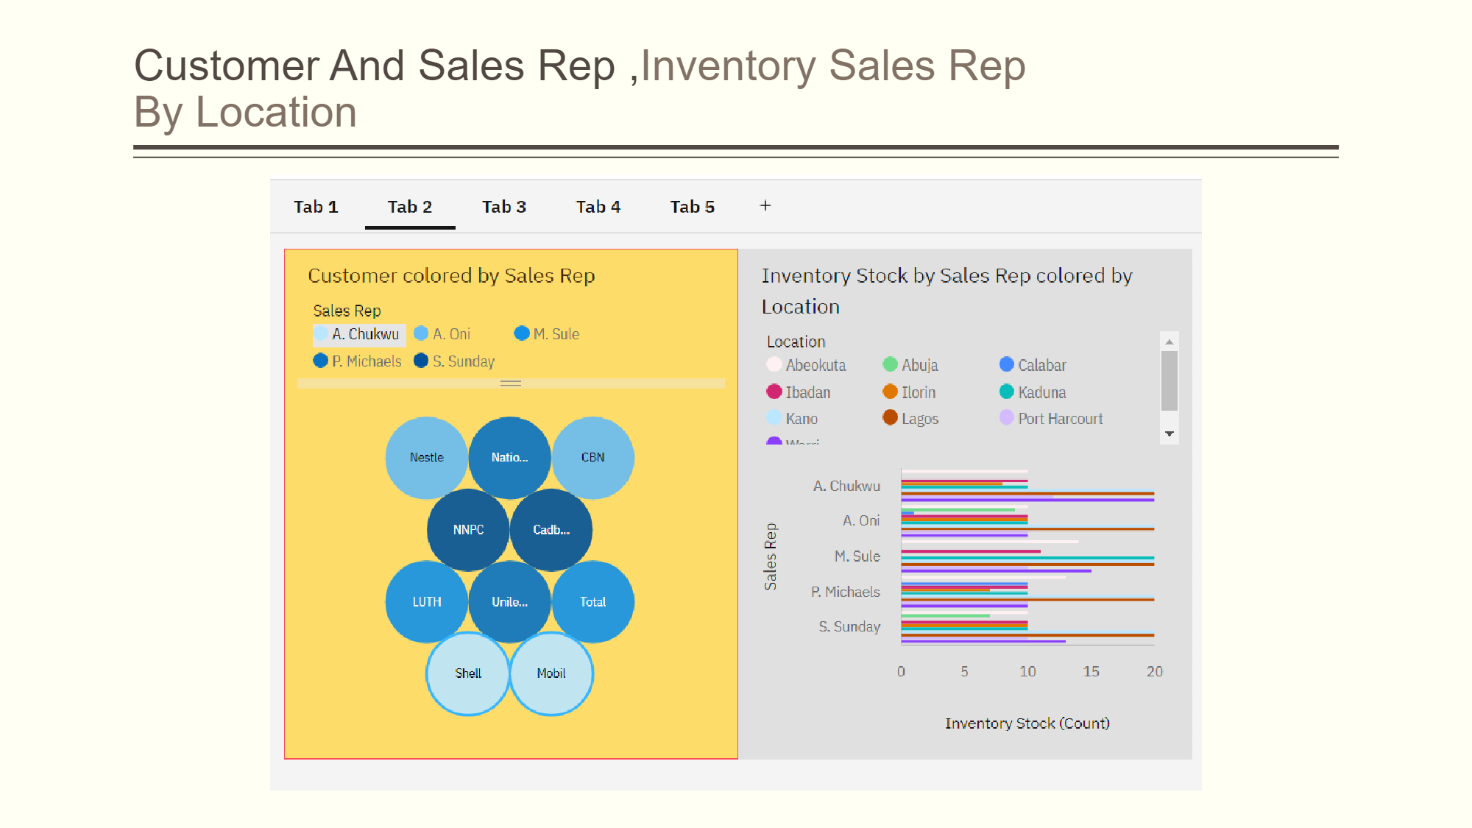

Slide 6
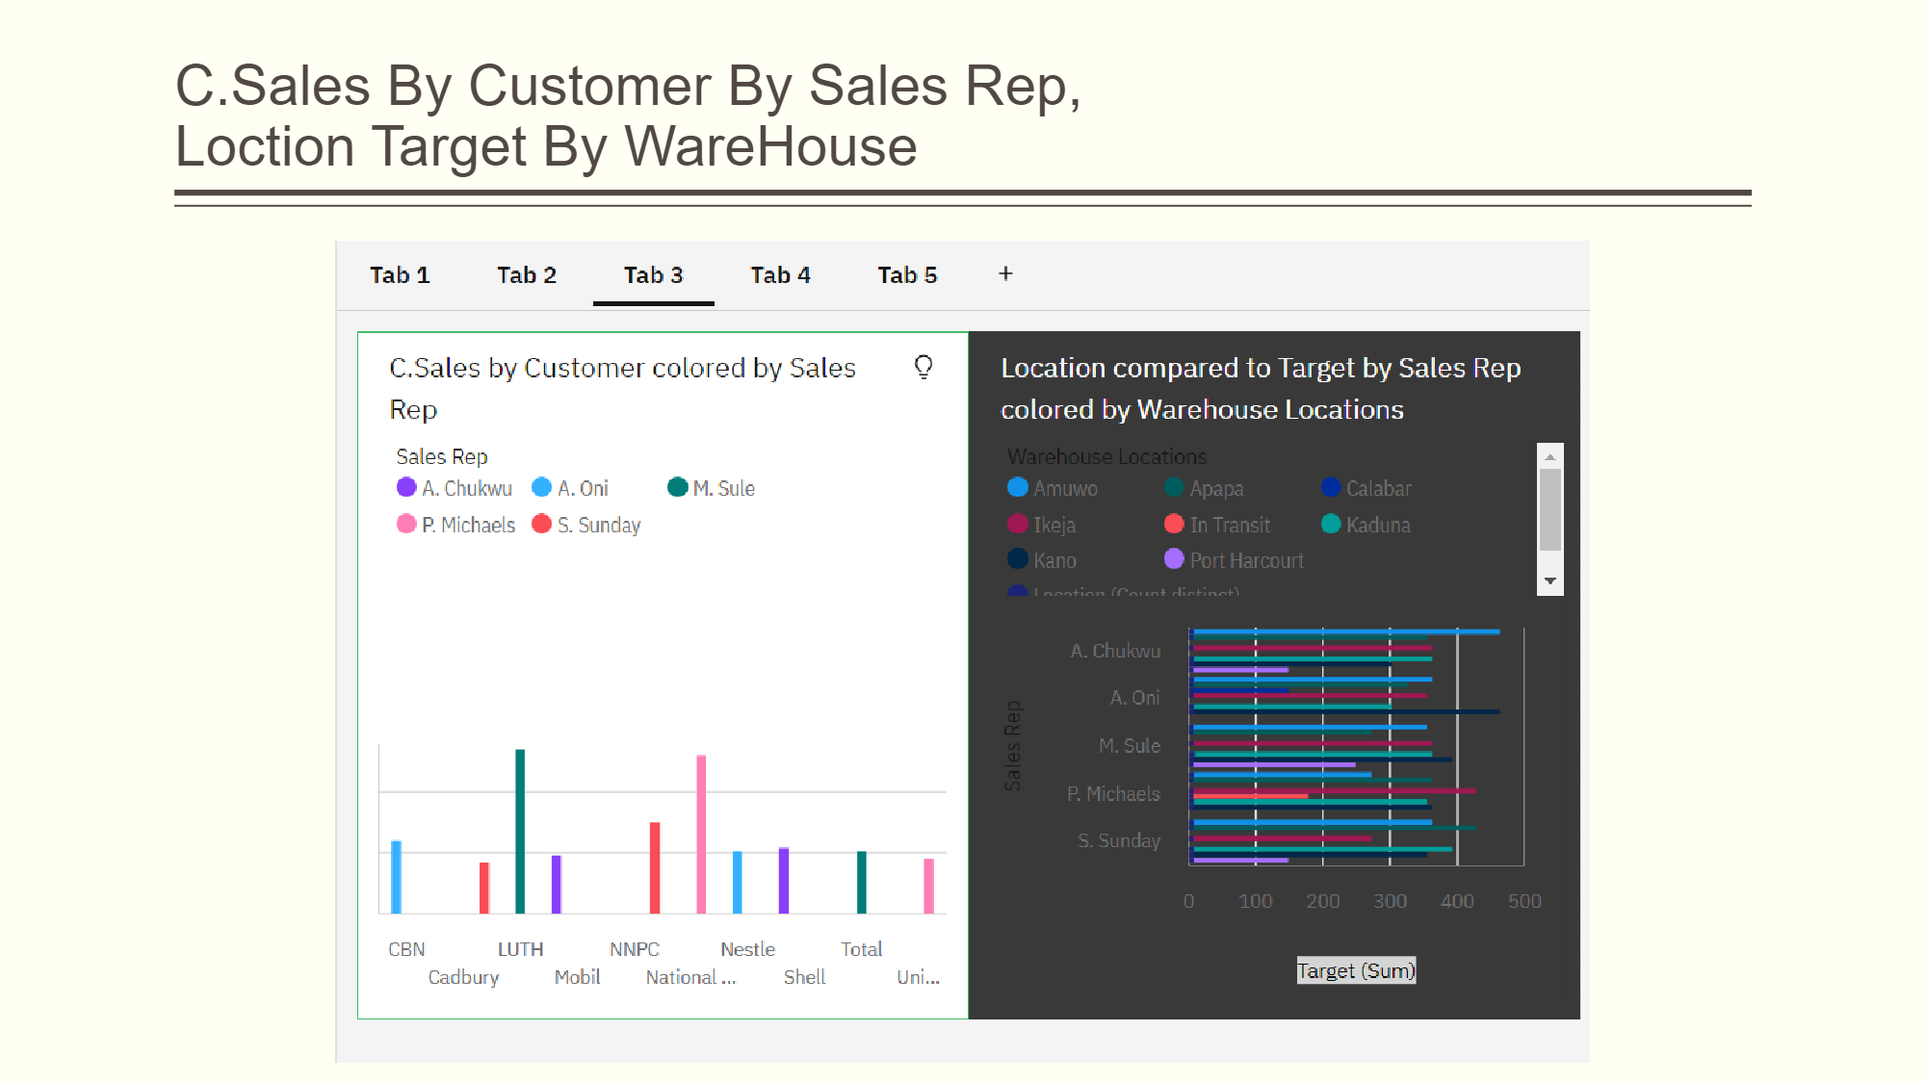

Slide 7
